Slide 1
Cross-Sectional Data Analysis
Econometric Models
Dr Peter Knížat
Statistical Office of the Slovak Republic
Comenius University in Bratislava

Slide 2
LEARNING OBJECTIVES
Learning Objectives – after completing this session, participants will be able to
explain the role of cross-sectional econometric models in official statistics and evidence-based policy-making;
download and prepare regional economic data directly from Eurostat using R;
specify and estimate a multiple linear regression model using Ordinary Least Squares (OLS);
interpret estimated regression coefficients, hypothesis tests, confidence intervals and measures of model fit;
assess the validity of econometric models using graphical and statistical diagnostic tests;
recognise common violations of OLS assumptions, including multicollinearity, heteroskedasticity, endogeneity and spatial autocorrelation;
estimate alternative regression models including Weighted Least Squares (WLS), Robust Regression (M-estimation), Instrumental Variable / GMM estimation, Quantile Regression and introduce Spatial Econometric Models;
interpret econometric results for policy analysis and support evidence-based decision-making.

Slide 3
MOTIVATION
Key Question – How can cross-sectional econometric models help transform regional data into evidence for policy-making?
Practical Problem – Estimation and interpretation of the regional unemployment dynamics using real Eurostat NUTS 2 data in R. Comparison of several estimation techniques and their suitability for official statistics.

Slide 4
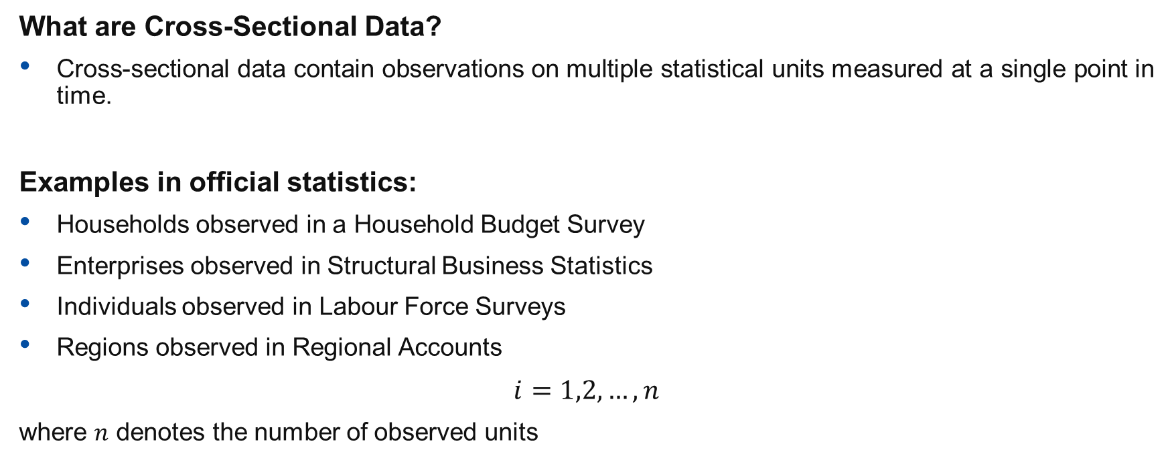
INTRODUCTION
What are Cross-Sectional Data?
Cross-sectional data contain observations on multiple statistical units measured at a single point in time.
Examples in official statistics:
Households observed in a Household Budget Survey
Enterprises observed in Structural Business Statistics
Individuals observed in Labour Force Surveys
Regions observed in Regional Accounts
$$i=1,2,…,n$$
where $n$ denotes the number of observed units

Slide 5
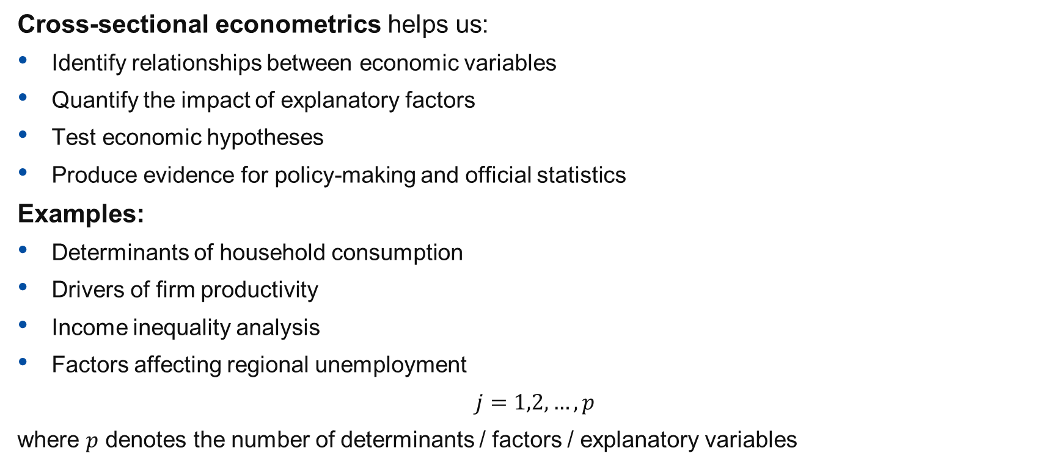
WHY DO WE ANALYSE CROSS-SECTIONAL DATA?
Cross-sectional econometrics helps us:
Identify relationships between economic variables
Quantify the impact of explanatory factors
Test economic hypotheses
Produce evidence for policy-making and official statistics
Examples:
Determinants of household consumption
Drivers of firm productivity
Income inequality analysis
Factors affecting regional unemployment
$$j=1,2,…,p$$
where $p$ denotes the number of determinants / factors / explanatory variables

Slide 6
DATA IN R
The automated data download: many economic data sources can be accessed and downloaded through R packages
Examples:
  Eurostat – library EUROSTAT (primary source)
  World Data Indicators – library WDI
We collect data for analysis directly in R

Slide 7
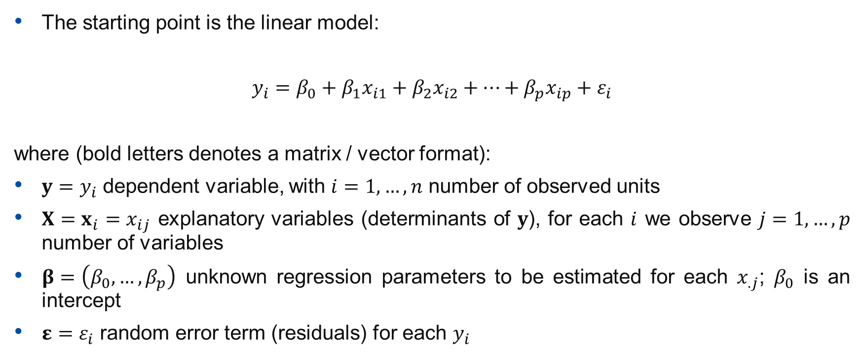
BASIC ECONOMETRIC MODEL FRAMEWORK
The starting point is the linear model:
$$y_{i}=β_{0}+β_{1}x_{i1}+β_{2}x_{i2}+…+β_{p}x_{ip}+ε_{i}$$
where (bold letters denotes a matrix / vector format):
$y=y_{i}$​ dependent variable, with $i=1,…,n$ number of observed units
$X=x_{i}=x_{ij}$​ explanatory variables (determinants of $y$), for each $i$ we observe $j=1,…,p$ number of variables
$β=\left(β_{0},…,β_{p}\right)$ unknown regression parameters to be estimated for each $x_{.j}$; $β_{0}$ is an intercept
$ε=ε_{i}$ random error term (residuals) for each $y_{i}$

Slide 8
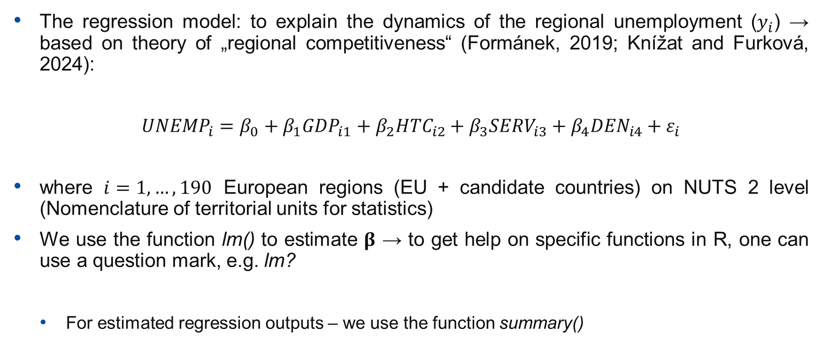
LINEAR REGRESSION IN R – DYNAMICS OF REGIONAL UNEMPLOYMENT
The regression model: to explain the dynamics of the regional unemployment ($y_{i}$) → based on theory of „regional competitiveness“ (Formánek, 2019; Knížat and Furková, 2024):
$${UNEMP}_{i}=β_{0}+β_{1}{GDP}_{i1}+β_{2}{HTC}_{i2}+β_{3}{SERV}_{i3}+β_{4}{DEN}_{i4}+ε_{i}$$
where $i=1,…,190$ European regions (EU + candidate countries) on NUTS 2 level (Nomenclature of territorial units for statistics)
We use the function lm() to estimate $β$ → to get help on specific functions in R, one can use a question mark, e.g. lm?
  For estimated regression outputs – we use the function summary()

Slide 9
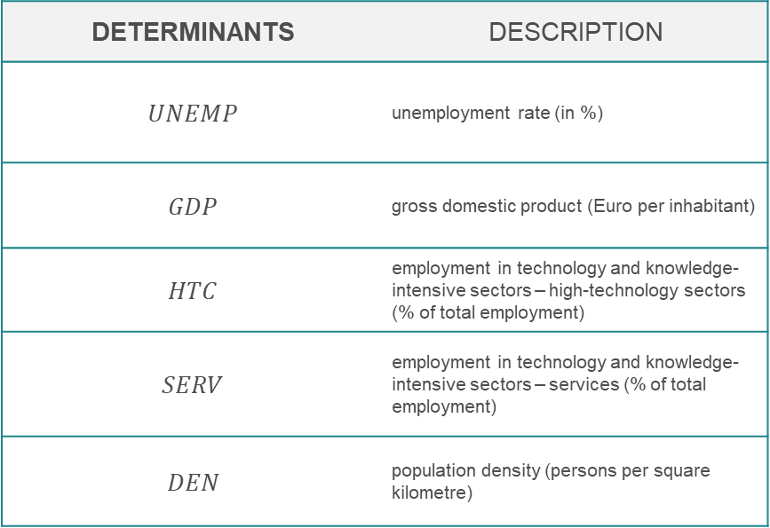
DYNAMICS OF REGIONAL UNEMPLOYMENT – KEY DETERMINANTS
DETERMINANTS | DESCRIPTION
$$UNEMP$$ | unemployment rate (in %)
$$GDP$$ | gross domestic product (Euro per inhabitant)
$$HTC$$ | employment in technology and knowledge-intensive sectors – high-technology sectors (% of total employment)
$$SERV$$ | employment in technology and knowledge-intensive sectors – services (% of total employment)
$$DEN$$ | population density (persons per square kilometre)

Slide 10
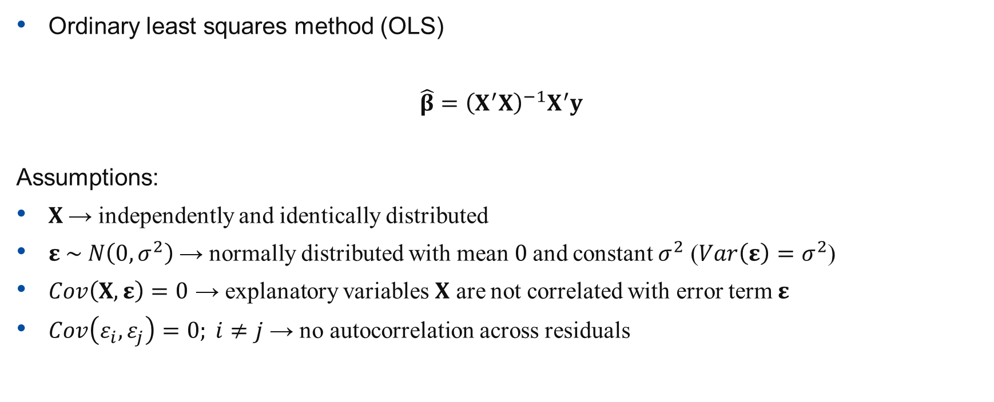
BASIC ESTIMATION OF ECONOMETRIC MODEL
Ordinary least squares method (OLS)
$$\hat{β}={\left(X^{′}X\right)}^{−1}X^{′}y$$
Assumptions:
$X$ → independently and identically distributed
$ε \sim N\left(0,σ^{2}\right)$ → normally distributed with mean $0$and constant $σ^{2}$ ($Var\left(ε\right)=σ^{2}$)
$Cov\left(X,ε\right)=0$​ → explanatory variables $X$ are not correlated with error term $ε$
$Cov\left(ε_{i},ε_{j}\right)=0; i≠j$ → no autocorrelation across residuals

Slide 11
ESTIMATION METHODS
MODEL | ESTIMATION METHOD | DESCRIPTION | ADVANTAGE
Linear | OLS (Ordinary Least Squares) | Explain regional differences in economic performance using education, investment, innovation, etc. | Simple interpretation and benchmarking
Weighted | WLS (Weighted Least Squares) | Give larger regions greater influence using population or employment weights | Reflects differing statistical importance of regions
Robust | M-estimation: Huber‘s Loss | Analysis with influential observations such as capital regions (e.g. Bratislava, Vienna) | Reduces impact of outliers
„Weak“ Linear (Instrumental variables) | Generalised Method of Moments (GMM) | Used when explanatory variables are endogenous or error terms exhibit heteroskedasticity. | Produces consistent estimates under weaker assumptions than OLS; accommodates heteroskedasticity and endogeneity through instrumental variables.
Quantile | Quantile Estimation | Assess whether determinants differ between less-developed and highly-developed regions | Captures heterogeneous effects across the distribution
Spatial (SAR, SEM etc.) | Maximum Likelihood | Measure spillover effects between neighbouring regions; Account for omitted spatially correlated factors; Explore whether relationships vary across geographic space | Explicitly models regional interdependence; Corrects for spatial autocorrelation in residuals; Allows coefficients to differ by location

Slide 12
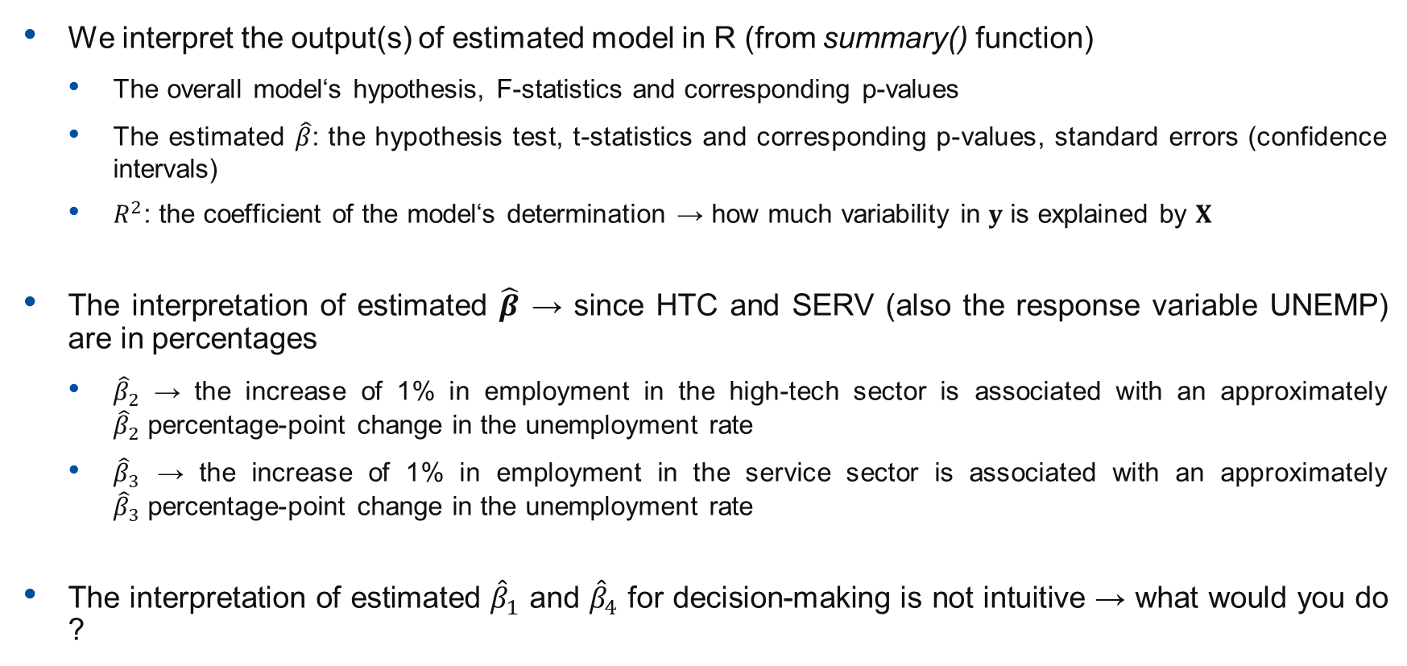
INTERPRETATION OF ESTIMATED MODEL‘S OUTPUTS
We interpret the output(s) of estimated model in R (from summary() function)
  The overall model‘s hypothesis, F-statistics and corresponding p-values
  The estimated $\hat{β}$: the hypothesis test, t-statistics and corresponding p-values, standard errors (confidence intervals)
  $R^{2}$: the coefficient of the model‘s determination → how much variability in $y$ is explained by $X$
The interpretation of estimated $\hat{β}$ → since HTC and SERV (also the response variable UNEMP) are in percentages
  ${\hat{β}}_{2}$ → the increase of 1% in employment in the high-tech sector is associated with an approximately ${\hat{β}}_{2}$ ​percentage-point change in the unemployment rate
  ${\hat{β}}_{3}$ → the increase of 1% in employment in the service sector is associated with an approximately ${\hat{β}}_{3}$ ​percentage-point change in the unemployment rate
The interpretation of estimated ${\hat{β}}_{1}$ and ${\hat{β}}_{4}$ for decision-making is not intuitive → what would you do ?

Slide 13
MODEL DIAGNOSTICS
The function plot() of the estimated econometric model in R outputs 4 graphs:
Residuals vs Fitted responses. Purpose: ✔Linearity ✔Homoscedasticity. Good model: random scatter, no pattern. Problems: funnel → heteroskedasticity; curve → nonlinear relationship.
Q-Q Residuals. Purpose: ✔Normality of residuals. Good model: points close to line. Problems: Heavy tails; Outliers.
Scale-Location. Purpose: ✔Constant variance. Good model: horizontal line. Problems: increasing spread → heteroskedasticity.
Residuals versus Leverage. Purpose: ✔Influential observations. Good model: no observations outside Cook's distance.

Slide 14
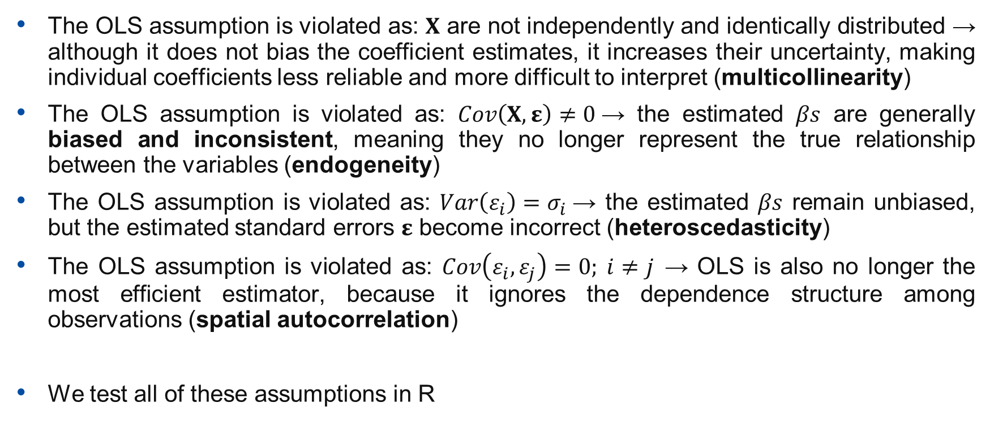
MODEL DIAGNOSTICS: MULTICOLLINEARITY, ENDOGENEITY, HETEROSCEDASTICITY, SPATIAL AUTOCORRELATION
The OLS assumption is violated as: $X$ are not independently and identically distributed → although it does not bias the coefficient estimates, it increases their uncertainty, making individual coefficients less reliable and more difficult to interpret (multicollinearity)
The OLS assumption is violated as: $Cov\left(X,ε\right)≠0$→ the estimated $βs$ are generally biased and inconsistent, meaning they no longer represent the true relationship between the variables (endogeneity)
The OLS assumption is violated as: $Var\left(ε_{i}\right)=σ_{i}$→ the estimated $βs$ remain unbiased, but the estimated standard errors $ε$ become incorrect (heteroscedasticity)
The OLS assumption is violated as: $Cov\left(ε_{i},ε_{j}\right)=0; i≠j$ → OLS is also no longer the most efficient estimator, because it ignores the dependence structure among observations (spatial autocorrelation)
We test all of these assumptions in R

Slide 15
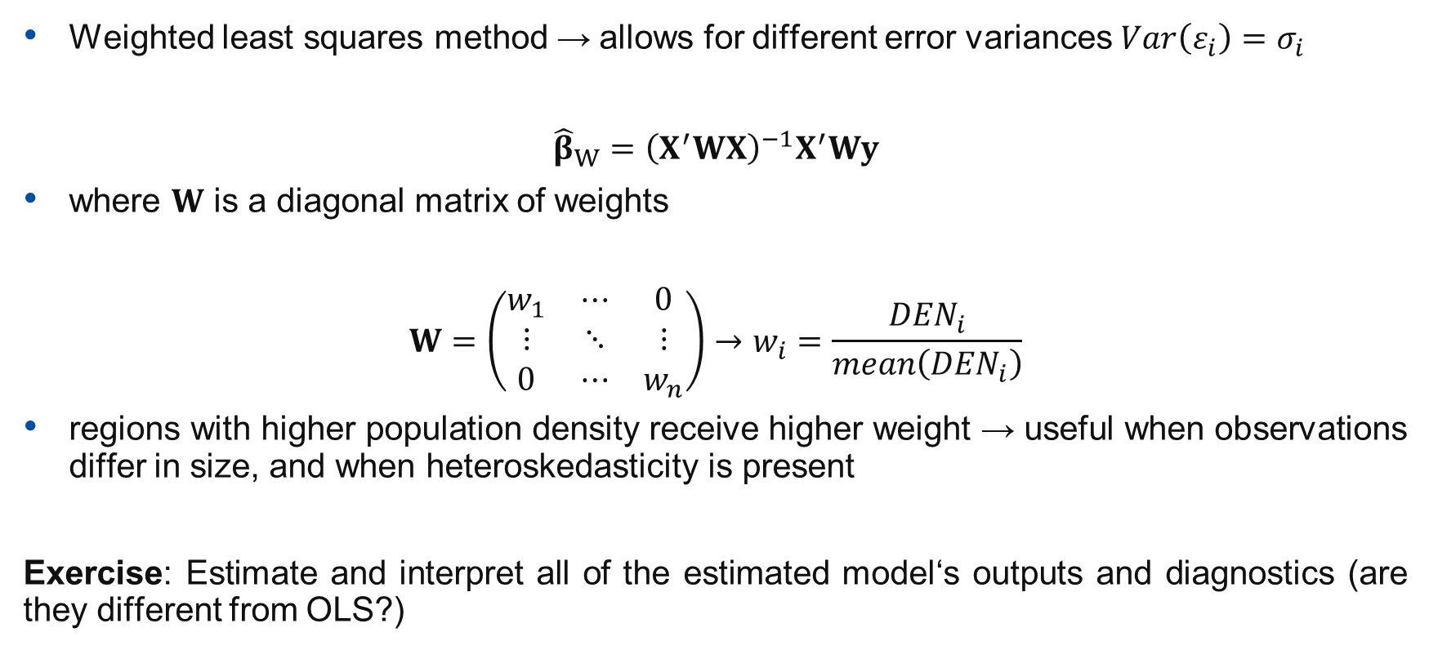
WEIGHTED ESTIMATION OF ECONOMETRIC MODEL
Weighted least squares method → allows for different error variances $Var\left(ε_{i}\right)=σ_{i}$
$${\hat{β}}_{W}={\left(X^{′}WX\right)}^{−1}X^{′}Wy$$
where $W$ is a diagonal matrix of weights
$$W=\left(\begin{matrix}w_{1} & ⋯ & 0 \\ ⋮ & ⋱ & ⋮ \\ 0 & ⋯ & w_{n}\end{matrix}\right)→w_{i}=\frac{{DEN}_{i}}{mean\left({DEN}_{i}\right)}$$
regions with higher population density receive higher weight → useful when observations differ in size, and when heteroskedasticity is present
Exercise: Estimate and interpret all of the estimated model‘s outputs and diagnostics (are they different from OLS?)

Slide 16
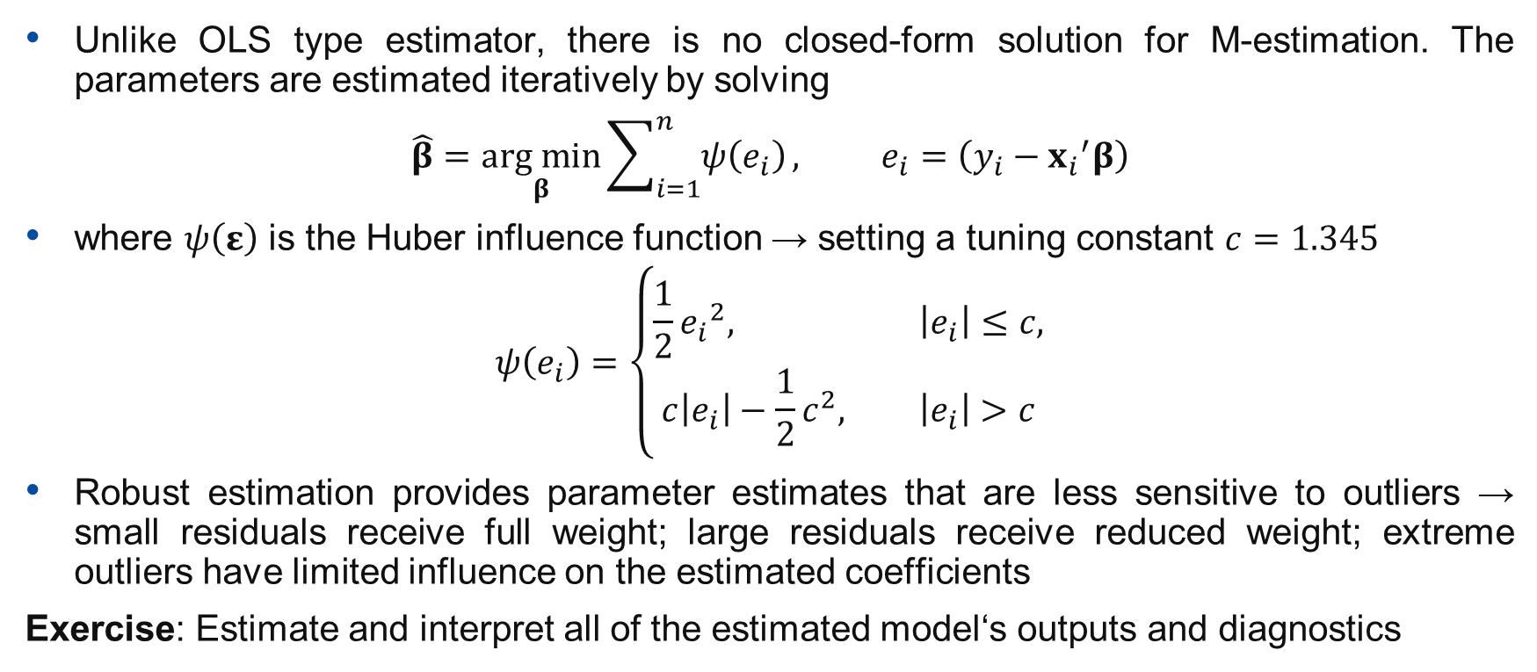
ROBUST ESTIMATION OF ECONOMETRIC MODEL
Unlike OLS type estimator, there is no closed-form solution for M-estimation. The parameters are estimated iteratively by solving
$$\hat{β}=\underset{β}{arg min}{\sum_{i=1}^{n}{ψ\left(e_{i}\right)}}, e_{i}=\left(y_{i}−{x_{i}}^{′}β\right)$$
where $ψ\left(ε\right)$ is the Huber influence function → setting a tuning constant $c=1.345$
$$ψ\left(e_{i}\right)=\left\{\begin{aligned}\frac{1}{2}{e_{i}}^{2}, \left|e_{i}\right|≤c, \\ c\left|e_{i}\right|−\frac{1}{2}c^{2}, \left|e_{i}\right|>c\end{aligned}\right.$$
Robust estimation provides parameter estimates that are less sensitive to outliers → small residuals receive full weight; large residuals receive reduced weight; extreme outliers have limited influence on the estimated coefficients
Exercise: Estimate and interpret all of the estimated model‘s outputs and diagnostics

Slide 17
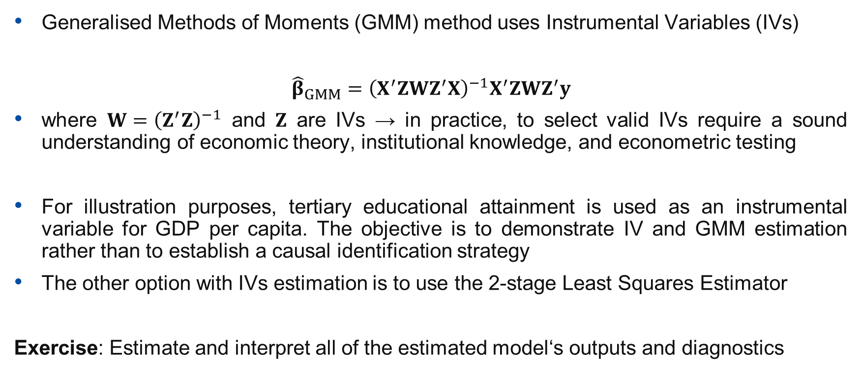
GMM ESTIMATION OF ECONOMETRIC MODEL
Generalised Methods of Moments (GMM) method uses Instrumental Variables (IVs)
$${\hat{β}}_{GMM}={\left(X^{′}ZWZ^{′}X\right)}^{−1}X^{′}ZWZ^{′}y$$
where $W={\left(Z^{′}Z\right)}^{−1}$ and $Z$ are IVs → in practice, to select valid IVs require a sound understanding of economic theory, institutional knowledge, and econometric testing
For illustration purposes, tertiary educational attainment is used as an instrumental variable for GDP per capita. The objective is to demonstrate IV and GMM estimation rather than to establish a causal identification strategy
The other option with IVs estimation is to use the 2-stage Least Squares Estimator
Exercise: Estimate and interpret all of the estimated model‘s outputs and diagnostics

Slide 18
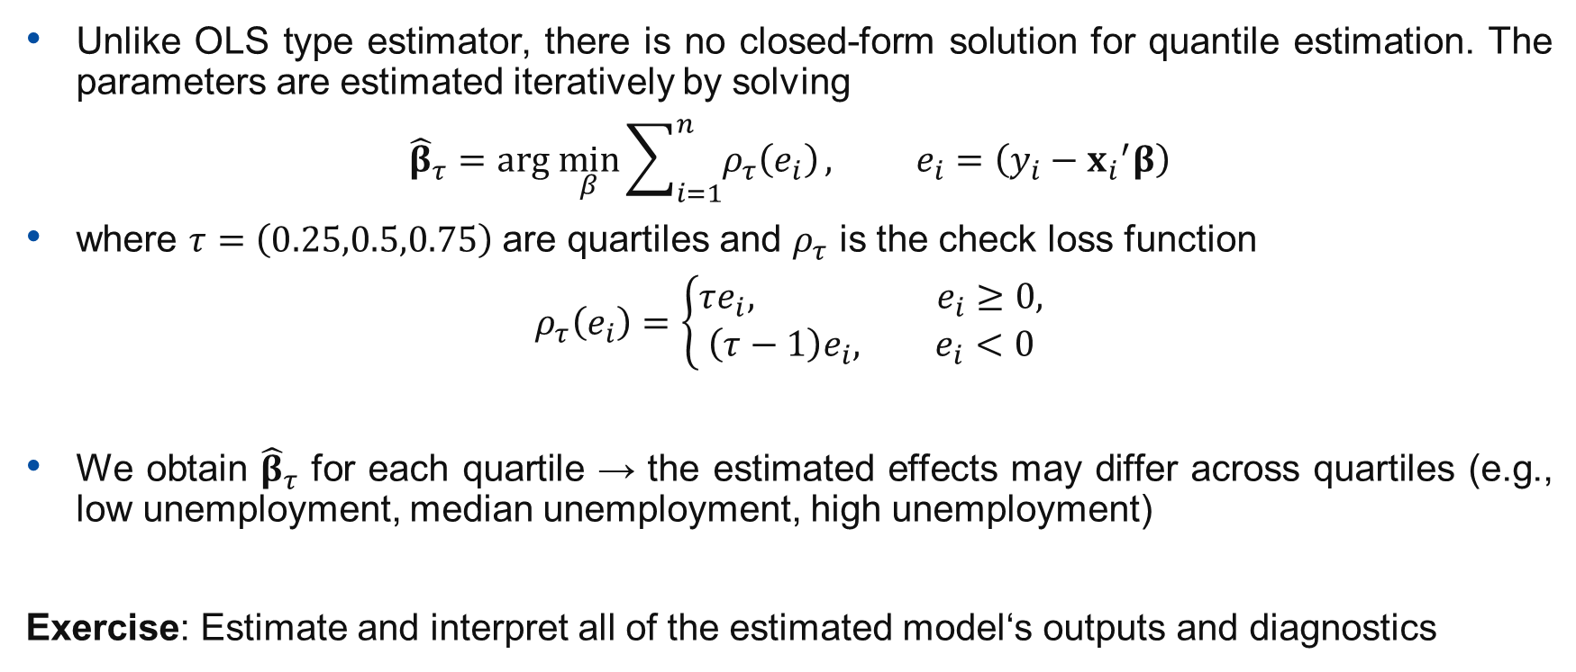
QUANTILE ESTIMATION OF ECONOMETRIC MODEL
Unlike OLS type estimator, there is no closed-form solution for quantile estimation. The parameters are estimated iteratively by solving
$${\hat{β}}_{τ}=arg \min_{β}{\sum_{i=1}^{n}{ρ_{τ}\left(e_{i}\right)}}, e_{i}=\left(y_{i}−{x_{i}}^{′}β\right)$$
where $τ=\left(0.25,0.5,0.75\right)$ are quartiles and $ρ_{τ}$ is the check loss function
$$ρ_{τ}\left(e_{i}\right)=\left\{\begin{aligned}τe_{i}, e_{i}≥0, \\ \left(τ−1\right)e_{i}, e_{i}<0\end{aligned}\right.$$
We obtain ${\hat{β}}_{τ}$ for each quartile → the estimated effects may differ across quartiles (e.g., low unemployment, median unemployment, high unemployment)
Exercise: Estimate and interpret all of the estimated model‘s outputs and diagnostics

Slide 19
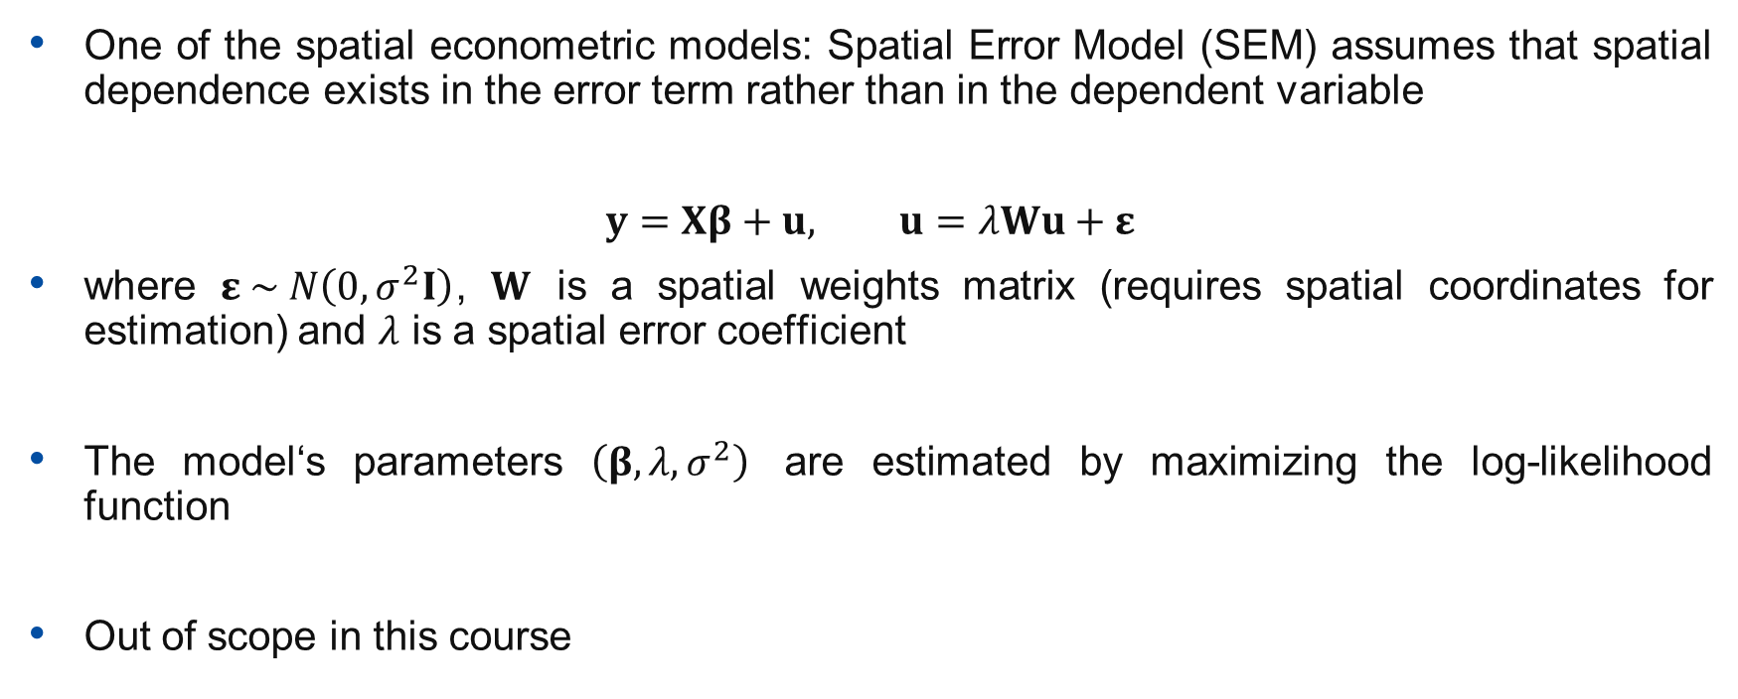
ESTIMATION OF SPATIAL ECONOMETRIC MODEL
One of the spatial econometric models: Spatial Error Model (SEM) assumes that spatial dependence exists in the error term rather than in the dependent variable
$$y=Xβ+u, u=λWu+ε$$
where $ε \sim N\left(0,σ^{2}I\right)$, $W$ is a spatial weights matrix (requires spatial coordinates for estimation) and $λ$ is a spatial error coefficient
The model‘s parameters $\left(β,λ,σ^{2}\right)$ are estimated by maximizing the log-likelihood function
Out of scope in this course

Slide 20
DATA TRANSFORMATION FOR ECONOMETRIC ANALYSIS – WHY?
The reason(s) for transformation → economic variables often violate the assumptions of standard regression models:
Highly skewed distributions (GDP, income, investment)
Non-linear relationships
Heteroskedasticity (variance increasing with size)
Different measurement scales
Outliers and extreme values
Difficulty interpreting coefficients
Different objectives for model interpretation
Data transformations can improve model fit, satisfy econometric assumptions, and facilitate interpretation.

Slide 21
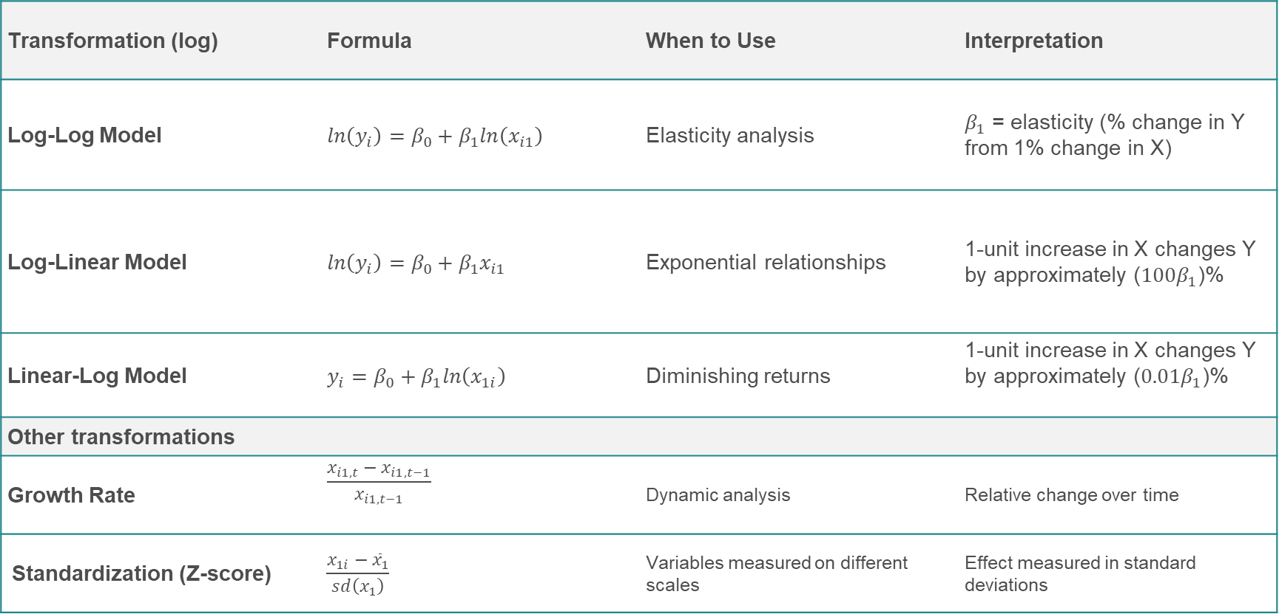
LOGARITHMIC DATA TRANSFORMATION IN ECONOMETRICS
Transformation (log) | Formula | When to Use | Interpretation
Log-Log Model | $$ln\left(y_{i}\right)=β_{0}+β_{1}ln\left(x_{i1}\right)$$ | Elasticity analysis | $β_{1}$ = elasticity (% change in Y from 1% change in X)
Log-Linear Model | $$ln\left(y_{i}\right)=β_{0}+β_{1}x_{i1}$$ | Exponential relationships | 1-unit increase in X changes Y by approximately ($100β_{1}$)%
Linear-Log Model | $$y_{i}=β_{0}+β_{1}ln\left(x_{1i}\right)$$ | Diminishing returns | 1-unit increase in X changes Y by approximately ($0.01β_{1}$)%
Other transformations
Growth Rate | $$\frac{x_{i1,t}−x_{i1,t−1}}{x_{i1,t−1}}$$ | Dynamic analysis | Relative change over time
Standardization (Z-score) | $$\frac{x_{1i}−{\overline{x}}_{1}}{sd\left(x_{1}\right)}$$ | Variables measured on different scales | Effect measured in standard deviations

Slide 22
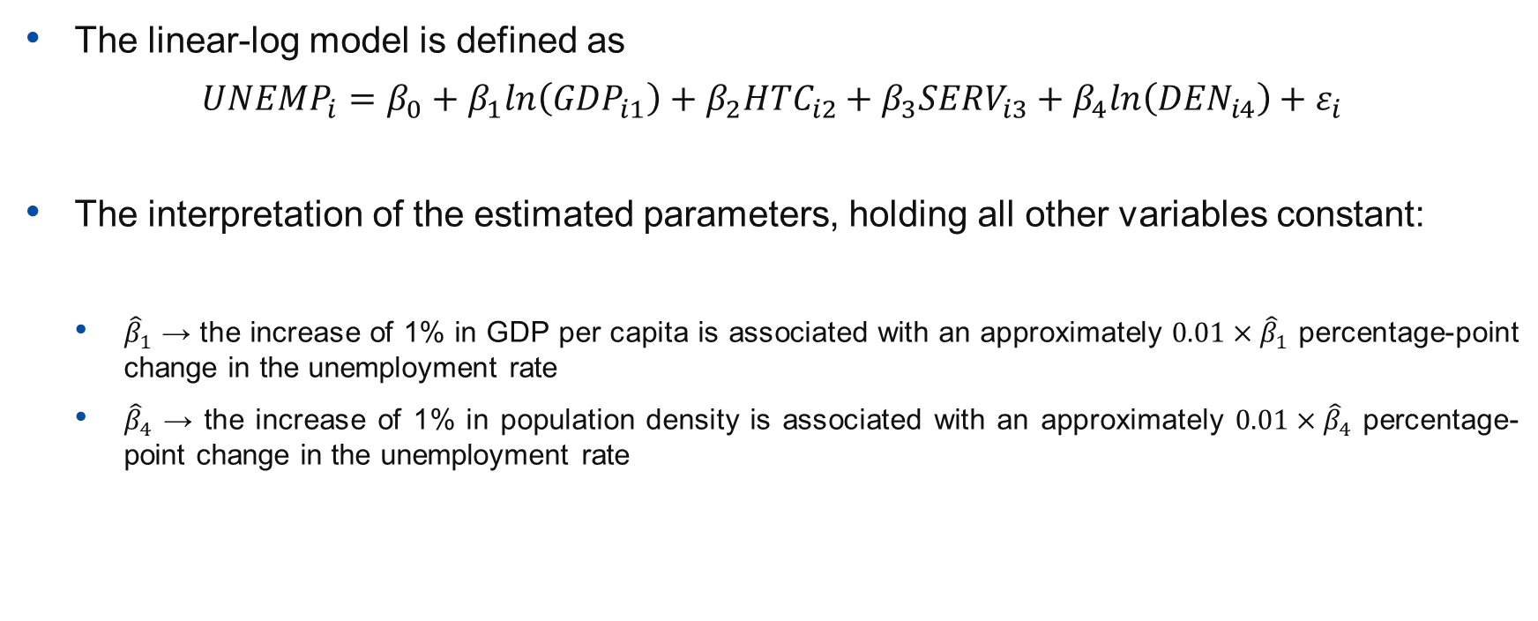
LINEAR-LOG MODEL
The linear-log model is defined as
$${UNEMP}_{i}=β_{0}+β_{1}ln\left({GDP}_{i1}\right)+β_{2}{HTC}_{i2}+β_{3}{SERV}_{i3}+β_{4}ln\left({DEN}_{i4}\right)+ε_{i}$$
The interpretation of the estimated parameters, holding all other variables constant:
  ${\hat{β}}_{1}$ → the increase of 1% in GDP per capita is associated with an approximately $0.01×{\hat{β}}_{1}$ ​percentage-point change in the unemployment rate
  ${\hat{β}}_{4}$ → the increase of 1% in population density is associated with an approximately $0.01×{\hat{β}}_{4}$ ​percentage-point change in the unemployment rate

Slide 23
INTERPRETATION OF ESTIMATED MODEL‘S OUTPUTS
Exercises:
  Use OLS to estimate the model in R
  Interpret all of the estimated model‘s outputs
  Interpret the estimated model‘s parameters
  HOMEWORK: Use other estimation techniques – which one would you prefer in practice?

Slide 24
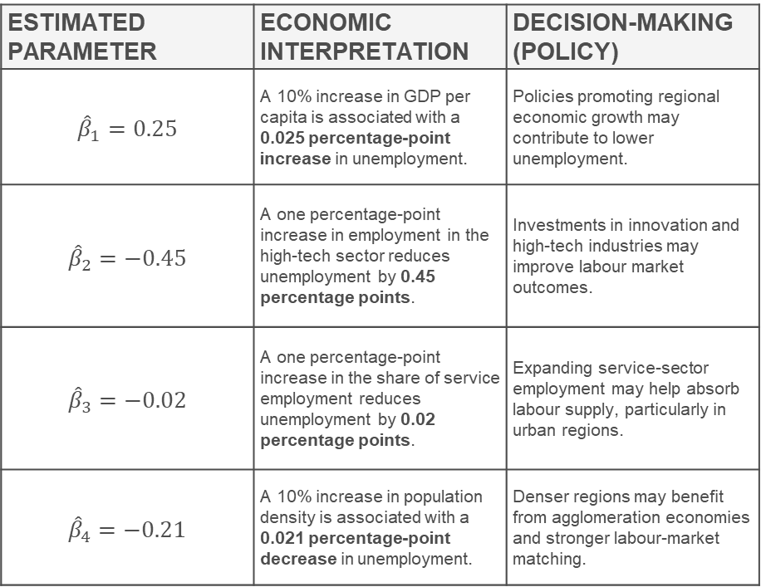
INTERPRETATION OF RESULTS FOR DECISION-MAKING
ESTIMATED PARAMETER | ECONOMIC INTERPRETATION | DECISION-MAKING (POLICY)
$${\hat{β}}_{1}=0.25$$ | A 10% increase in GDP per capita is associated with a 0.025 percentage-point increase in unemployment. | Policies promoting regional economic growth may contribute to lower unemployment.
$${\hat{β}}_{2}=−0.45$$ | A one percentage-point increase in employment in the high-tech sector reduces unemployment by 0.45 percentage points. | Investments in innovation and high-tech industries may improve labour market outcomes.
$${\hat{β}}_{3}=−0.02$$ | A one percentage-point increase in the share of service employment reduces unemployment by 0.02 percentage points. | Expanding service-sector employment may help absorb labour supply, particularly in urban regions.
$${\hat{β}}_{4}=−0.21$$ | A 10% increase in population density is associated with a 0.021 percentage-point decrease in unemployment. | Denser regions may benefit from agglomeration economies and stronger labour-market matching.
From Statistics to Decisions
  Regions experiencing a 10% increase in GDP per capita tend to exhibit unemployment rates that are approximately 0.025 percentage points higher, holding other factors constant
Budget of €100 million to reduce regional unemployment – which determinant would you target first and why? → Increase innovation and high-tech employment?; Improve transport infrastructure to stimulate GDP?; Support the service sector?; Focus on lagging regions?
Econometric models do not make policy decisions – they provide quantitative evidence to support policy decision-making. Decision-makers must also consider costs, feasibility, equity, and long-term objectives.

Slide 25
Thank you
Contact: peter.knizat@statistics.sk
knizat3@uniba.sk

